Slide 1
Module 2: Unsupervised Learning on Network Traffic
Principal Component Analysis and Clustering
ML for Cybersecurity
Fall 2020

Slide 2
Learning Objective

Slide 3
Learning Objectives
Review unsupervised learning concepts
Learn when unsupervised learning is appropriate in networking contexts (e.g., anomaly detection)
Apply unsupervised learning to a simple networking example
Learn about clustering and its applications to network data

Slide 4
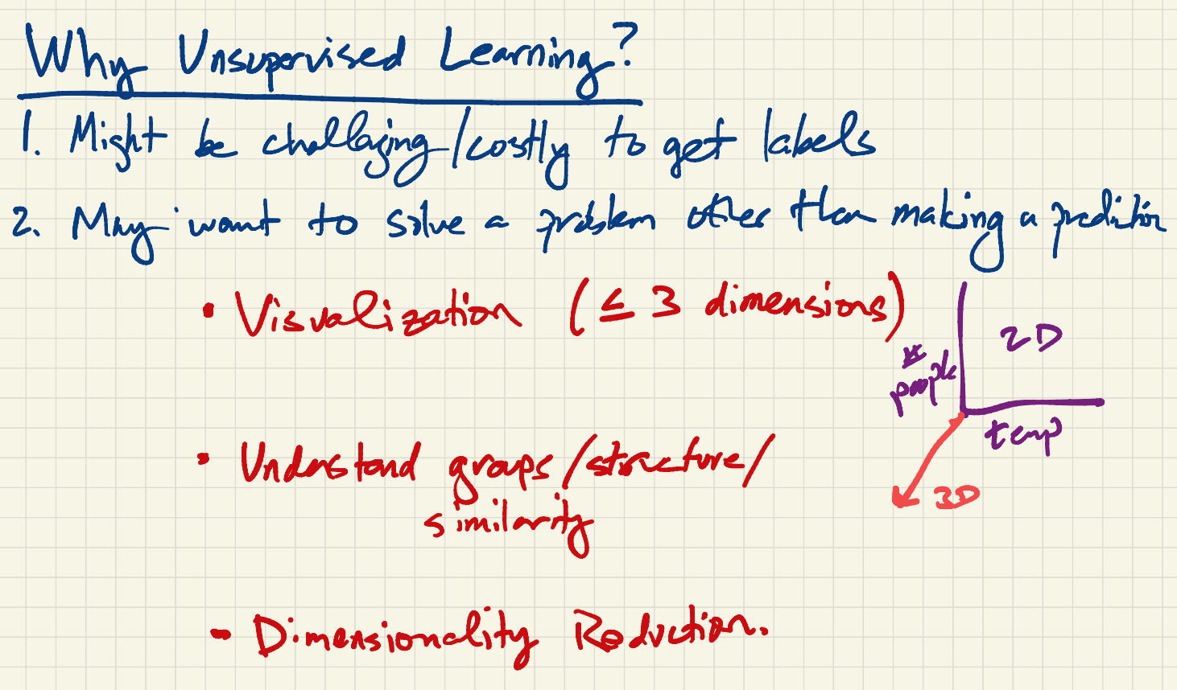
Notes:
Duplicate of Yuxin’s work?

Slide 5
Applications of Unsupervised Learning
Clustering
Dimensionality Reduction
Visualization

Slide 6
Principal Component Analysis

Slide 7
Principal Component Analysis
Coordinate transformation method
Original Data
Transformed Data
PC2
PC1
x2
PC2
x2
u2
u1
u2
PC1
u1
x1
x1
x1 , x2
u1 , u2
Notes:
At its heart PCA is a coordinate transformation method, best shown by an example.
On the left we have some data in their original axis representation, an XY axis. The data is a set of correlated rv as defined by this ellipse here.
PCA works by finding a new set of axis to describe this data, called the pc axis.
These axis have two special properties:
First, each PC axis captured the max energy in the data. And second, they are orthogonal to each other.
Ex, PC1 here basically amounts to a linear regression of the 2d data.
Once these axis are formed, each ponit x1 x2 in the original data can be now described in the new coordinate space, formed by the pc axis, as u1 u2.
All we’ve done therefore is to find a new set of axis and map the original data in the new axis.

Slide 8
Properties of Principal Components
Each PC in the direction of maximum (remaining) energy in the set of OD flows
Ordered by amount of energy they capture
Eigenflow: set of OD flows mapped onto a PC; a common trend
Ordered by most common to least common
Notes:
Generalizinig this to OD flows is as follows.
Each PC captures the maximum energy in the data.
In this way, the PCs are ordered by the amount of energy they capture.
The transformed points, the u1 u2 in the last slide, are what we call eigenflows now. Each eigenflow is a mapping of the OD flows onto a PC. Therefore, each eigenflow is a timeseries that captures a trend common across all OD flows.
Because the PCs are ordered by their energy, the eigenflows are also ordered by importance – from the trend that’s most common to the trend that is least common in all the OD flows.

Slide 9
PCA on OD flows
# OD pairs
# OD pairs
# OD pairs
time
time
# OD pairs
OD flow
Eigenflow
PC
X:
V:
Principal matrix
OD flow
matrix
U:
Eigenflow matrix

Slide 10
Example Traffic Flows
Notes:
So having done all this data processing, here are example of some sample OD flows.

Slide 11
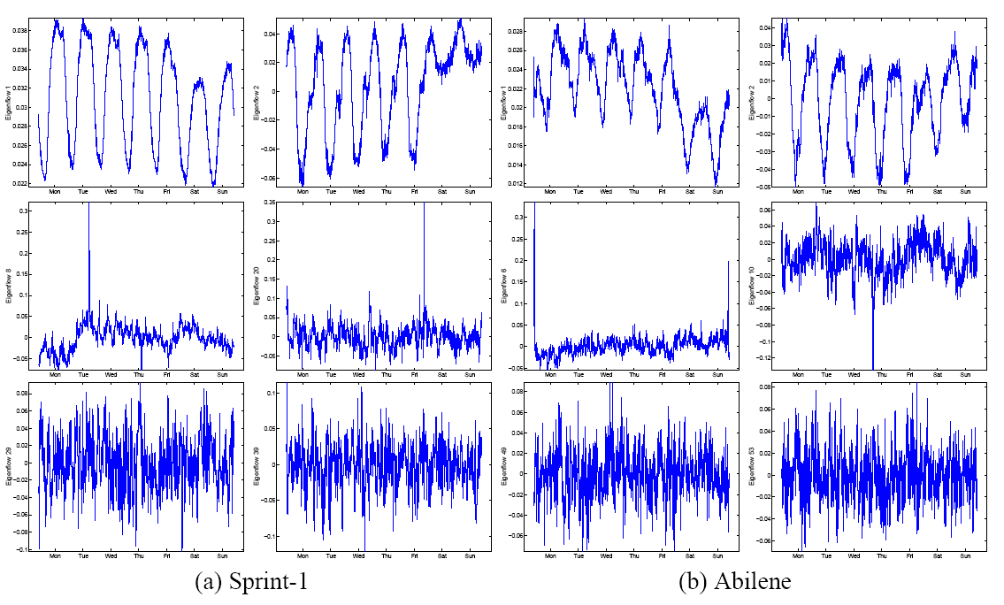
Dimensionality Reduction on Traffic Flows
Notes:
Here is an example of eigenflows. After visually inspecting the set of all eigenflows, three clear patterns emerged.
We have some eigenflows here that are periodic.
Some that have sharp sikes.
And these look roughly like noise.

Slide 12
Application: Anomaly Detection
Is my network experiencing unusual conditions?
Then, adopt the following framework
Detection Is there an unusual event?
Identification Which of the possible explanations fits best?
Quantification How serious is the problem?
Notes:
Our work begins with the observation that the problems I just mentioned are all really special cases of the more basic and general question: is my network experiencing an unusual condition.
This is a pretty broad and difficult question and so to answer it, we separated it into 3-steps:
The first step is to detect when something has gone wrong.
The next step is to identify what exactly it is, perhaps an attack or an outage.
And the final step is to quantify its impact, and if its great, to alert operators so that the necessary mitigation steps can be taken.

Slide 13
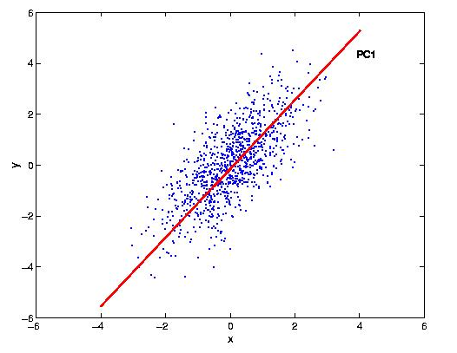
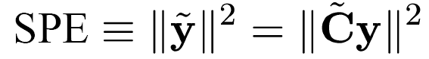
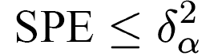
Subspace Method: Detection
Error Bounds on Squared Prediction Error:
Assuming multivariate Gaussian data, traffic is normal when,
Result due to [Jackson and Mudholkar, 1979]
Traffic on Link 2
Traffic on Link 1
Notes:
Detection involves finding the points in time when an unusual event has occurred. As I mentioned before, detection is really a problem of finding outliers. And I’ve also shown you before that an anomaly will tend to cause a large change in ytilde. So really what we want to be able to do is find large values in y-tilde. A useful statistic to detect unusual changes is to examine the squared prediction error, which is basically the squared L2 norm of y-tilde as shown here.
Jackson and Mudholkar derived thresholds for the residual vector, as captured by the SPE. This is given by delta squared alpha. Here delta-squared alpha denotes the threshold for the 1-alpha level confidence in the multivariate normal distribution. So if you chose alpha to be 0.1%, then points outside this threshold will correspond to points that lie outside the 99.9% of the multivariate mean. So essentially this is our false alarm rate under the assumption of normal traffic data. Their result basically puts bounds on values on the residual vector, as shown in this plot for the 2dimensional case. Any point outside these green lines, will correspond to an anomaly. What I’ve not shown here and whats important about this test is that it does not depend on the amount of traffic in the network, and so one can apply the same test on networks of different sizes and different utilization results. Now lets see how well this test works in practice.

Slide 14
Clustering

Slide 15
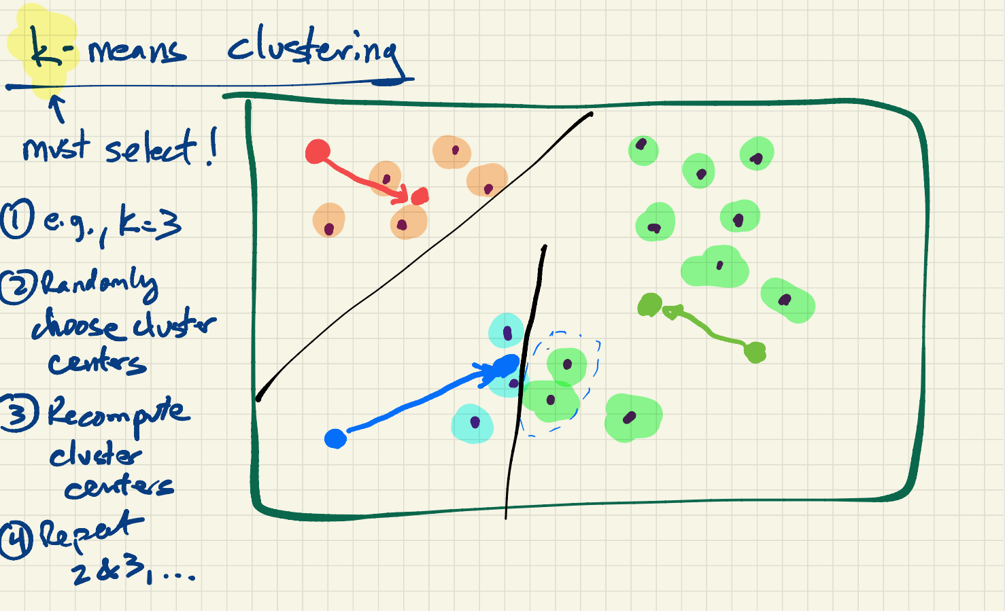
Notes:
Add example of application of k-Means clustering in security (+review)

Slide 16
Application of K-Means: Example

Slide 17
Other Clustering Algorithms and Applications

Slide 18
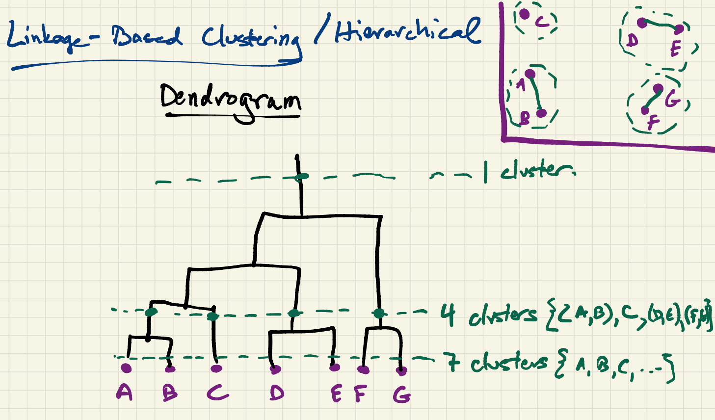

Slide 19
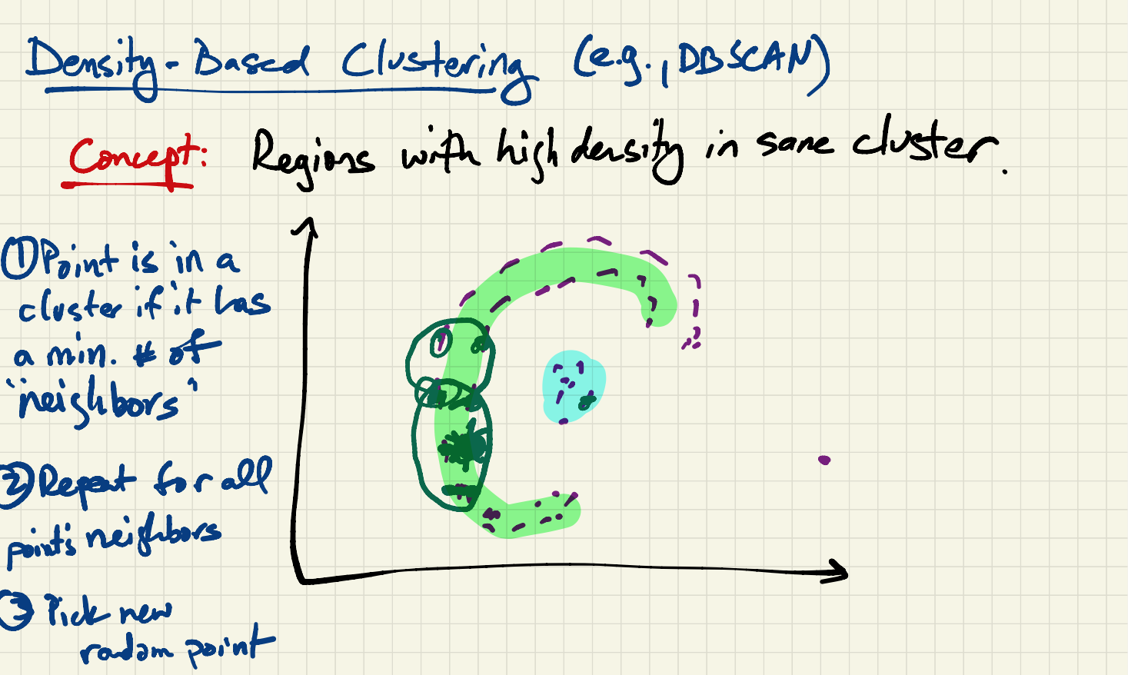

Slide 20
